Slide 1
Class, Ethnicity, age or Education: What Characteristics Determine Citizens’ Sense of Political Commonality? Author: Noam Titelman (2023)
Replication Study
By Aryan Goyal

Slide 2
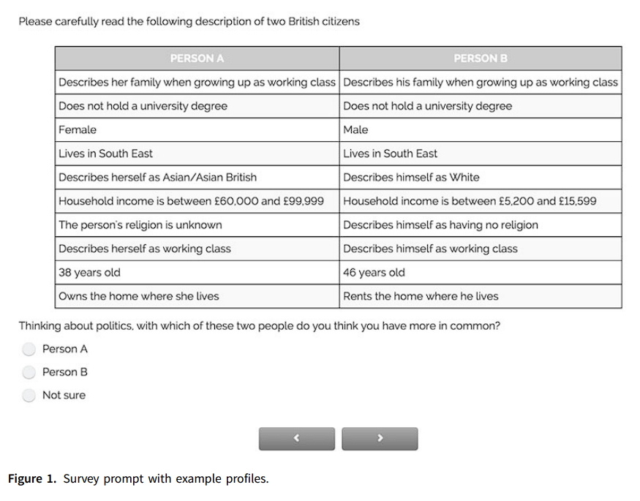
Original Study
The author wants to determine which social identities are more important for how people perceive political commonality between themselves and other citizens
Respondents are presented with the profiles of two fellow citizens, including several demographic attributes.
Respondents are asked which of the two they perceive themselves to have more in common with in terms of politics

Slide 3
Original study
Existing literature has focused largely on how demographic characteristics (Ethnicity, Age) themselves explain vote choice
The author suggests analysing the associations between demographic groups and voting does not reveal the relative importance of the corresponding social identities to politics
Hence, Titelman hopes to understand which characteristics (Gender, ethnicity etc) are more important for people to feel a sense of political commonality with others
By using a novel measurement strategy, they compare the relative strength of different social identities in the population from the perspective of how citizens perceive one another politically, rather than from their tendency to vote together.
The original study does not explicitly state any hypotheses
To analyze the results of the experiment, information on the respondents’ self-categorization is combined with that of the profiles presented to them and their choices. The analysis seeks to assess the probability of a respondent choosing one profile if that profile shares an attribute with the respondent and the other alternative profile does not.

Slide 4
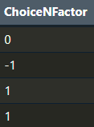
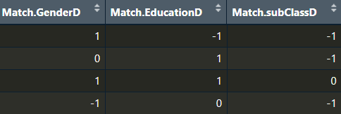
Data
Input variable: Does [characteristic] of respondent match with [characteristic] in profile
Coded as:
[Characteristic] matches in Profile A = 1
Matches in both/neither = 0
[Characteristic] matches in Profile B = -1
Outcome variable: Respondents’ choice of profile
Coded as:
Respondent chooses Profile A = 1
Not sure = 0
Respondent chooses Profile B = -1

Slide 5
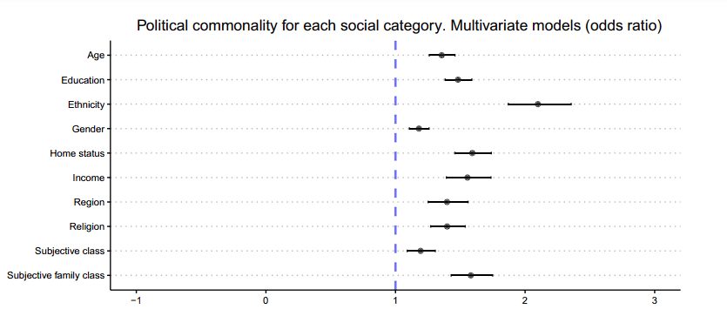
original study’s model
The author runs an ordinal logistic regression model
All the matching coefficients are statistically significant at the 95 per cent confidence level.
This model is hard to interpret intuitively in the manner that we have learned in this class
The coefficients correspond to how strongly a respondent matching a profile on a given attribute predicts the respondent choosing that profile as having more political commonality with themselves.
This confirms that, on average, people are more likely to feel political commonality with people who share their social identity categories for all the characteristics in the study.

Slide 6
My contribution
My solution:
Relevel the variables to a dummy variable (0 and 1)
1 = The [characteristic] of respondent matches the profile
0 = No match
Run a logistic regression model instead
What does this model tell us?
On average, a 1 unit increase in x (Going from no match to match), the odds of the respondent picking a profile with the matching characteristic increase/decrease by a multiplicative factor of exp(𝜷1), holding all other variables constant
Issues with current study:
Original study has a confusing ordinal scale
This scale makes the findings hard to interpret
How to substantively interpret the original model?
Compared to the reference category (-1), for each unit increase in x, the odds of moving to a higher category increase by a multiplicative factor of exp(𝜷1), holding all other variables constant.

Slide 7
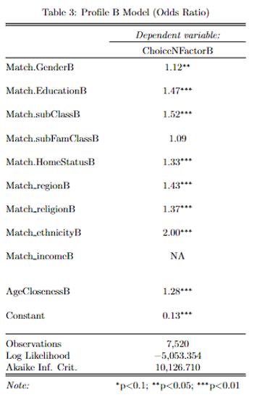
Comparing models
What does this model represent?
This model explains the odds of a respondent picking Profile B if the respondent’s [characteristic] matches the characteristic in the profile
Findings from this model:
The odds ratio values are generally similar to the original model
The coefficient for Family class is not significant anymore
Example interpretation:
When the respondent’s ethnicity matches the one in Profile B, the odds of the respondent selecting Profile B increase by a multiplicative factor of 2.00 on average, while holding all other variables constant
This model also raises questions:
The original dataset has no instances where the income of the respondent matches the income of Profile B

Slide 8
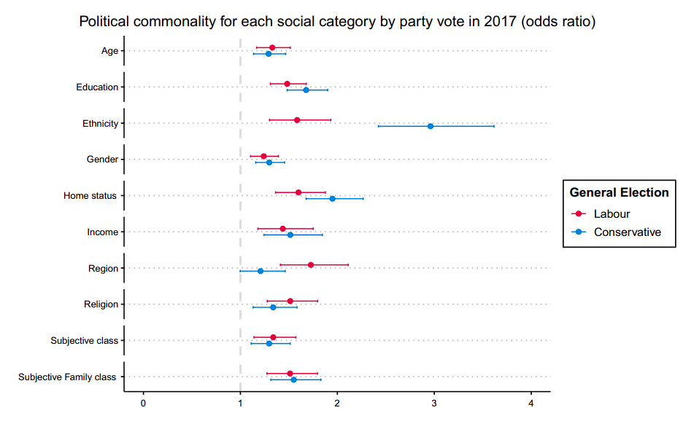
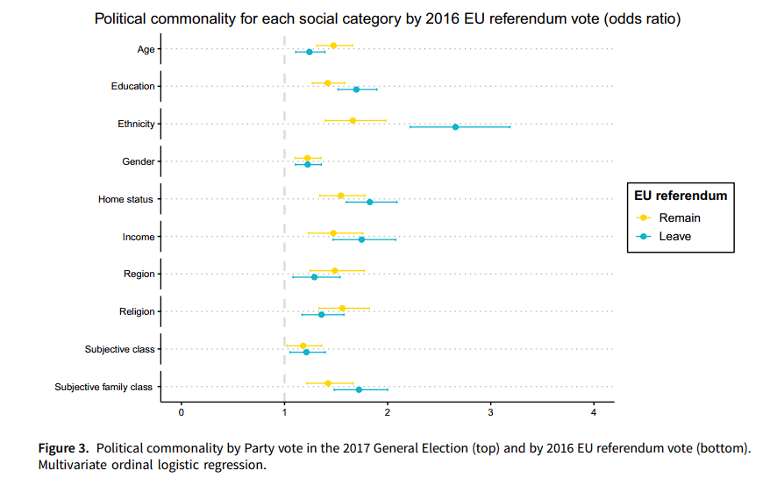
Figure 3 from original study

